Slide 1
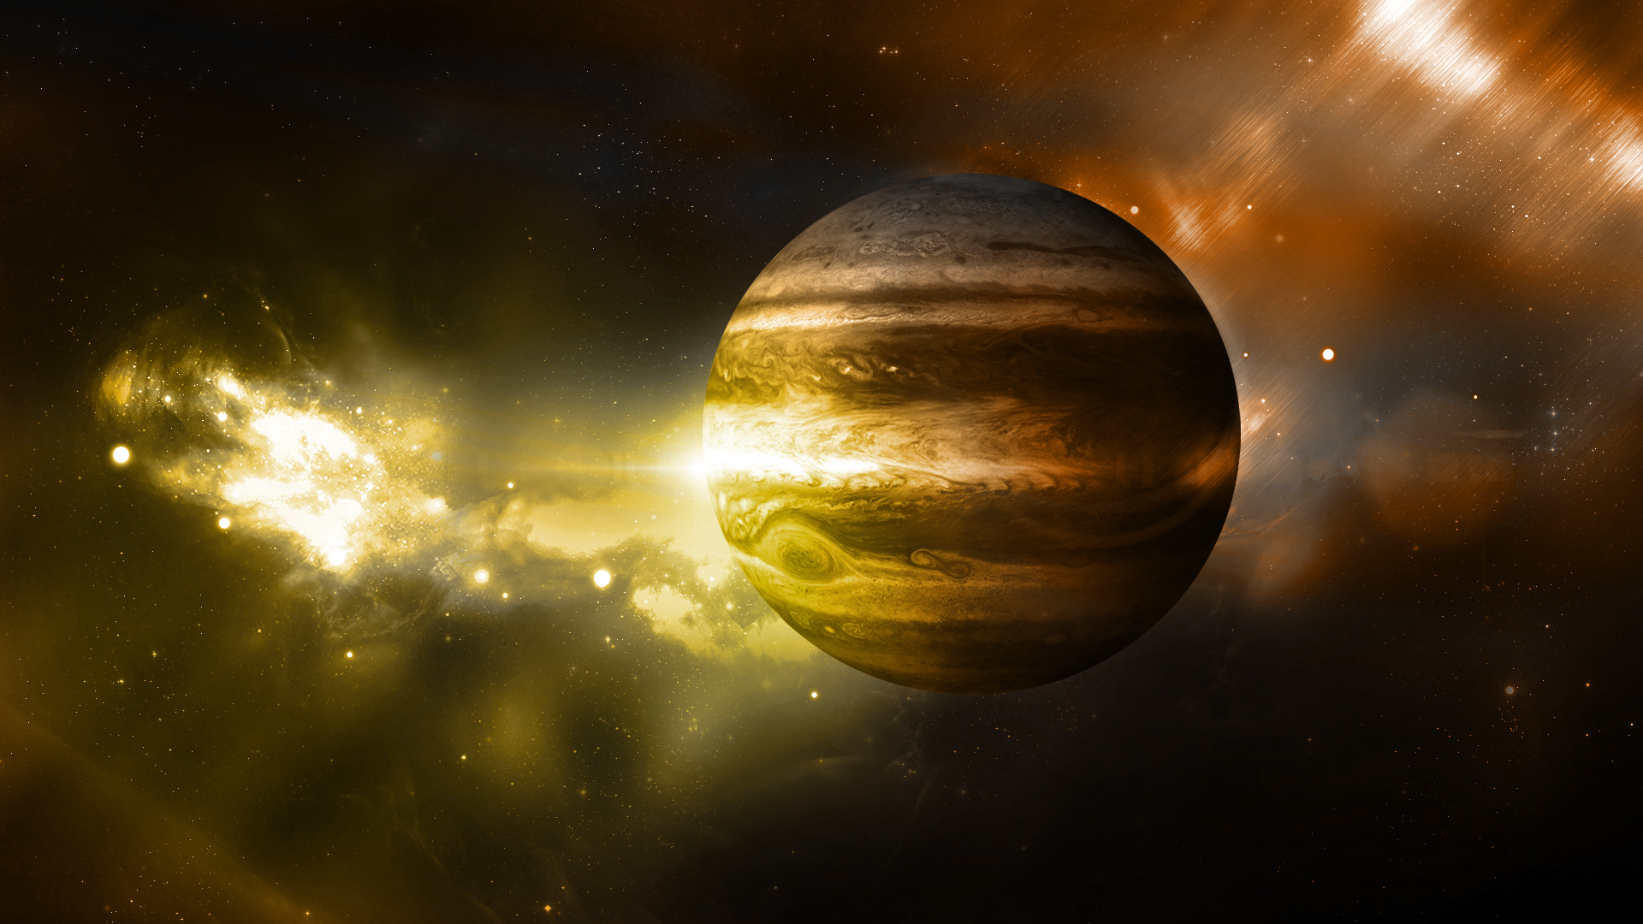



Basics of Artificial Neural Networks (ANN)

Slide 2
Intro
Intro
Properties
Application

Slide 3
Intro
Intro
Properties
Application

Slide 4
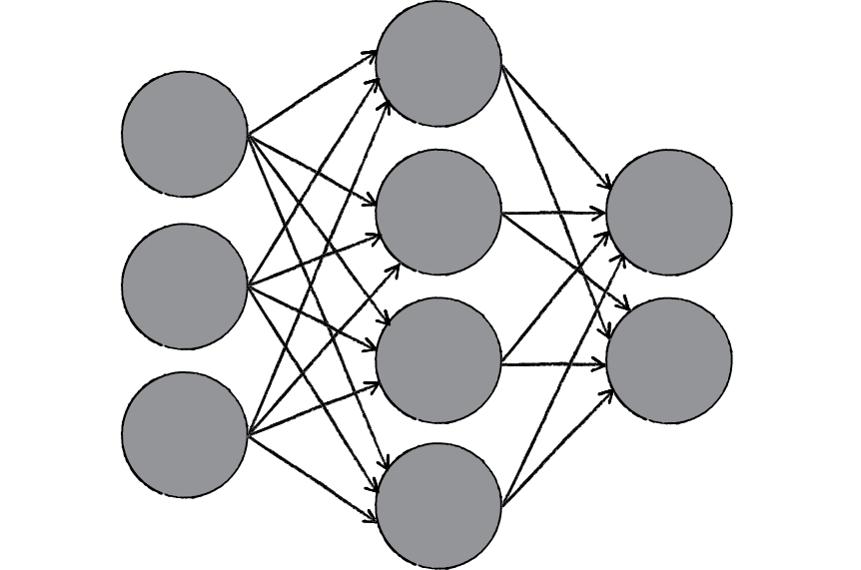
Intro/Definition
ANN:
Network of small Computation Units (Neurons)
Inspired by Brain
Computation Model
Not a Simulation
Connections: Synapses

Slide 5
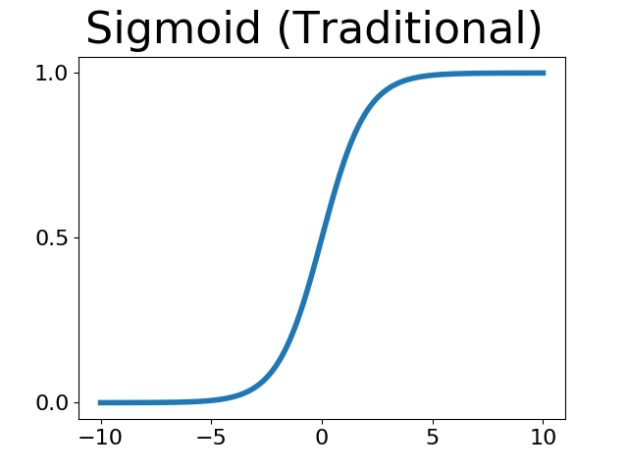
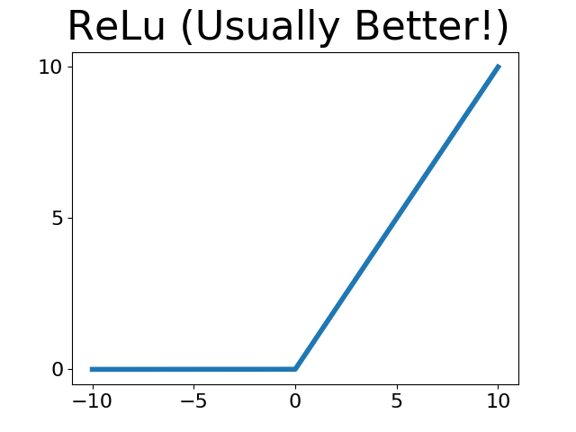
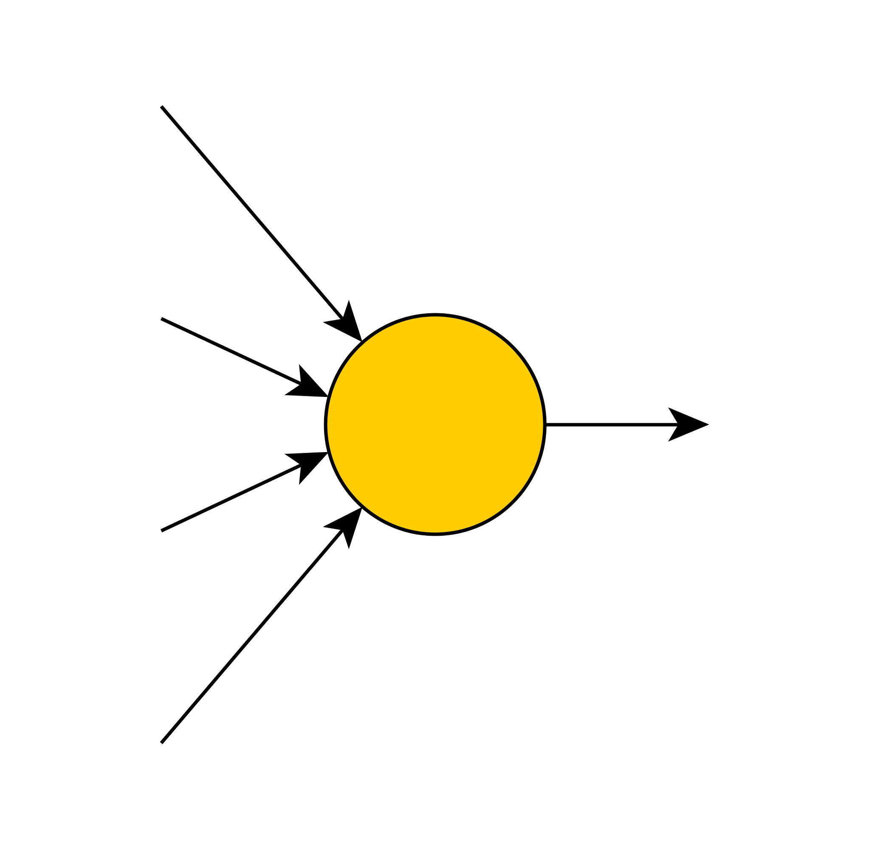
Intro/Single Perceptron
Activation Function:
(non-linear!)
Bias
Weights
(Weighted Sum: Logit)

Slide 6
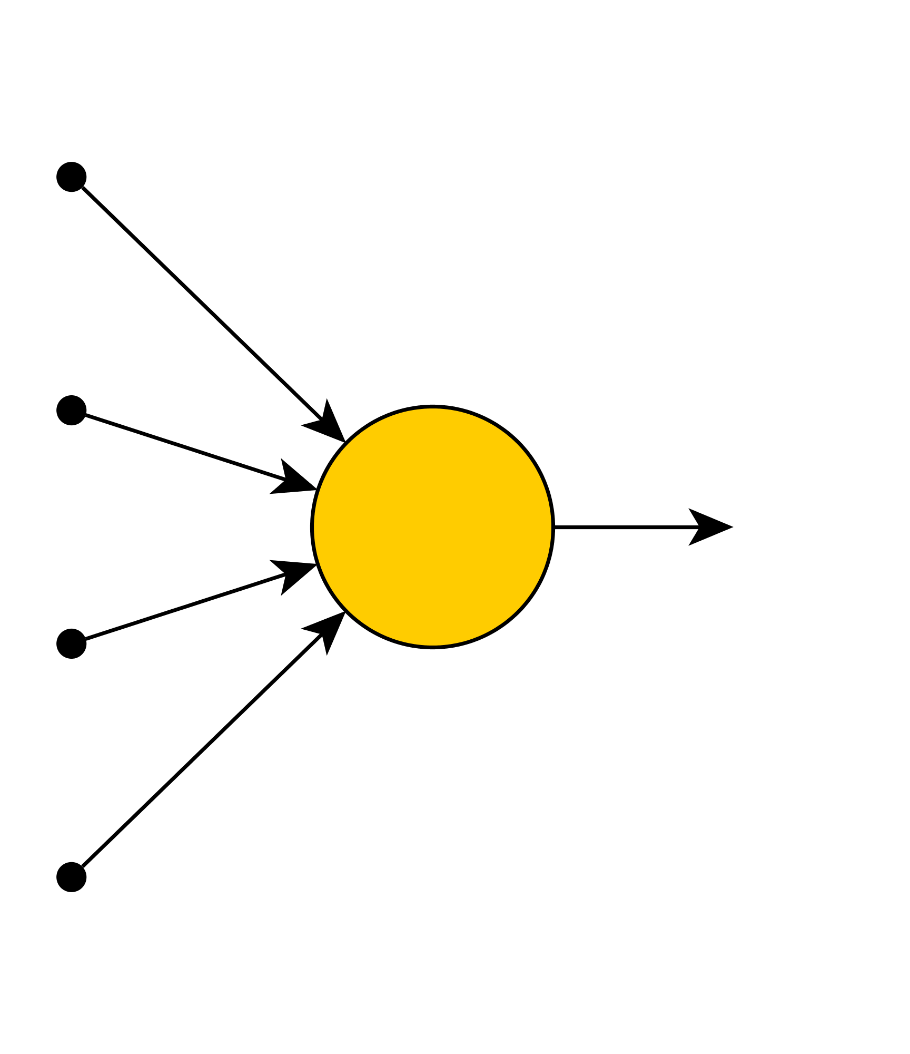
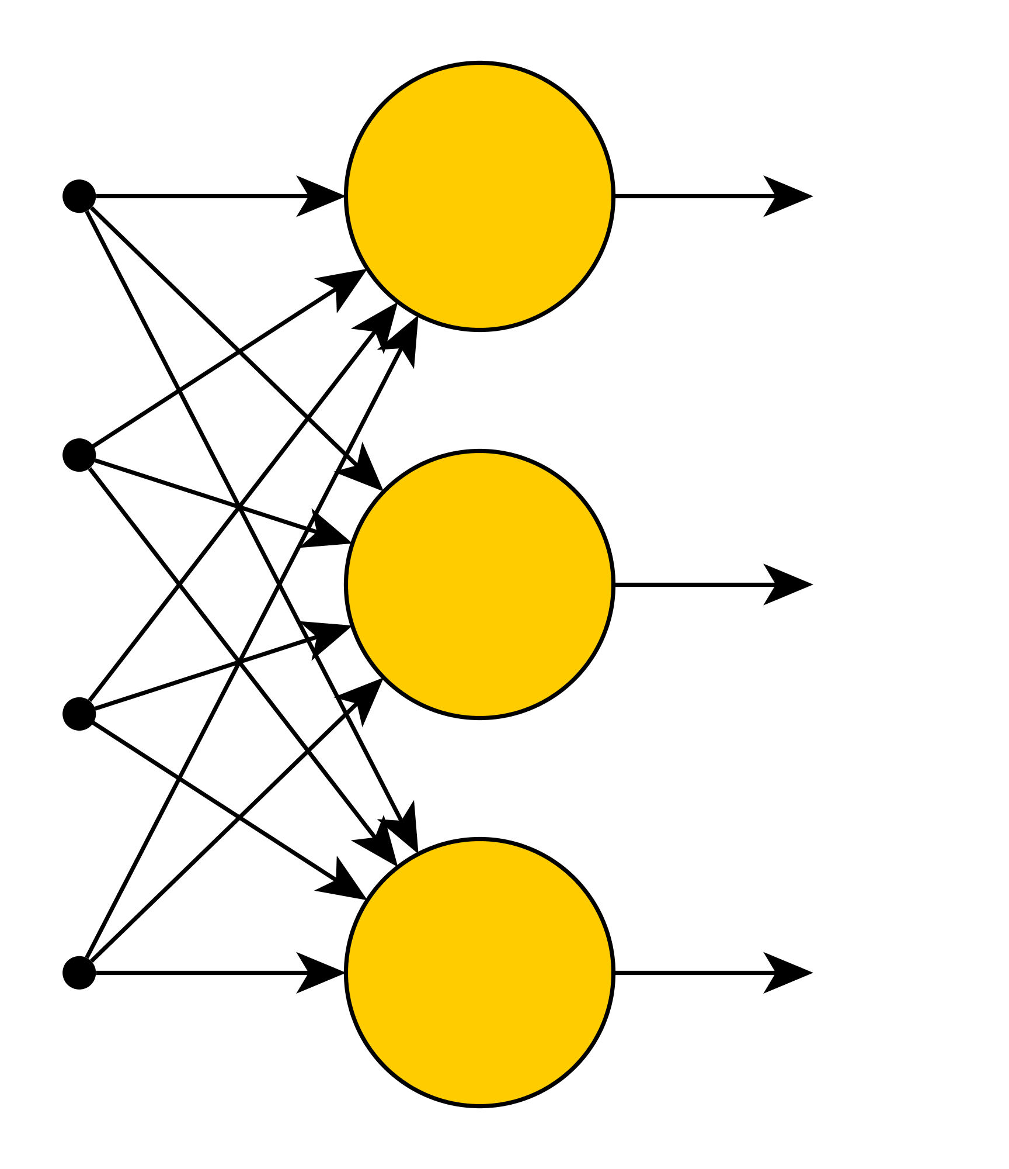
Intro/Layers
1 Output/Perceptron
Use multiple
Organized in Layers
Weighted sum
Matrix multiplication:

Slide 7
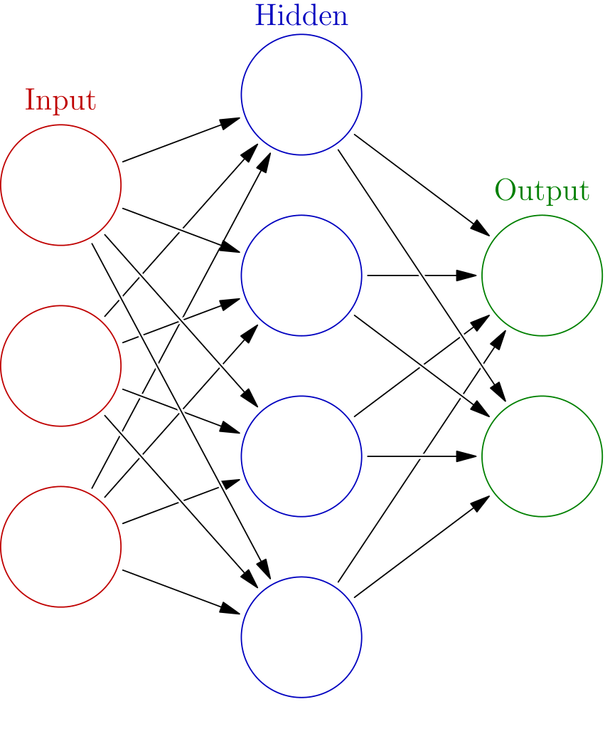
Intro/Multi-Layer Perceptron
Layers Stackable
Deep NN

Slide 8
Intro/Softmax Layer
Sums up to 1
Probability-Like
Classification

Slide 9
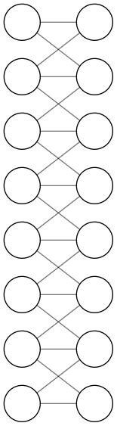
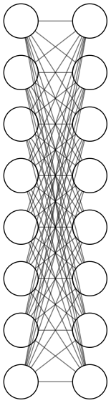
Intro/Convolutional Layer
Fully Connected Layer
10³ Neurons Each
10⁶ Synapses
Reduce Synapes to
„Neighborhood“
Works well for
Images or Sequences

Slide 10
Properties
Intro
Properties
Application

Slide 11
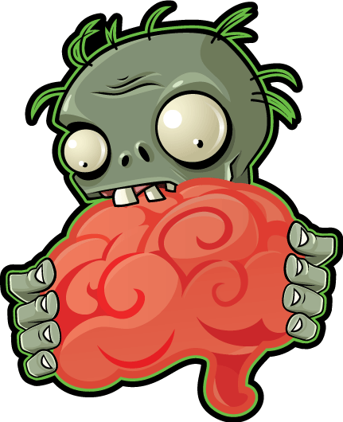
Properties
Why are ANN so powerful/popular?
They‘re like a human brain?
  Not really… but…
Model any (mathematical) Function!
Some ANN Touring complete
(model any computer program)
They are trainable
(/fittable/optimizable/programmable)
Think of a computer program that writes itself
  albeit not perfectly...

Slide 12
Properties/Boolean Logic

Slide 13
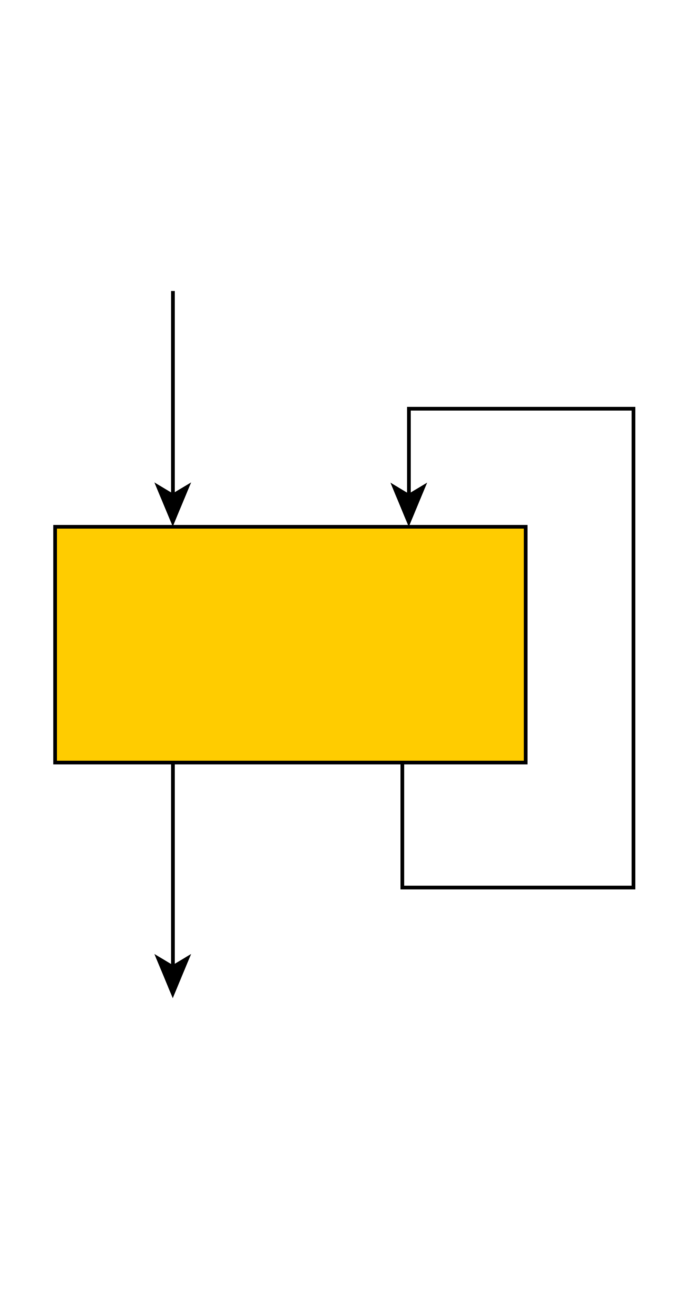
Properties/Memory
We‘ve got boolean logic!
Whats missing for Touring Completeness?
  Memory!
Recurrent Neural Networks RNN
Some outputs fed back as inputs
Special (forgetful) cells
  LSTM (Long Short-Term Memory)
  GRU, ...

Slide 14
Properties/Trainability
Outputs of ANN can be trained
Requires loss/error function, e.g. mean squared error
ANN well derivable → fast optimization
  Computed automaticall by Tensorflow, PyTorch, …
(Stochastic) Gradient Descent (SGD) as Opimizer
  better than complicated Methods
  Process: Feed-Forward & Back-Propagation

Slide 15
That‘s it! - Questions?

Slide 16
Sources
Definition ANN [Slide 4]:
http://natureofcode.com/book/chapter-10-neural-networks/
MLP Layers [Slide 7]:
https://en.wikipedia.org/wiki/Artificial_neural_network
Zombie Brain [Slide 11]:
http://plantsvszombies.wikia.com/wiki/File:HDZombieAndBrain.png
Remaining images created with yEd
https://www.yworks.com/products/yed

